Slide 1
Open-Source Final Project
Team 5

Slide 2
Contents
1
1
About Project
2
Demo Video
3
Open-Source
4
Our Team
5
Live Demo

Slide 3
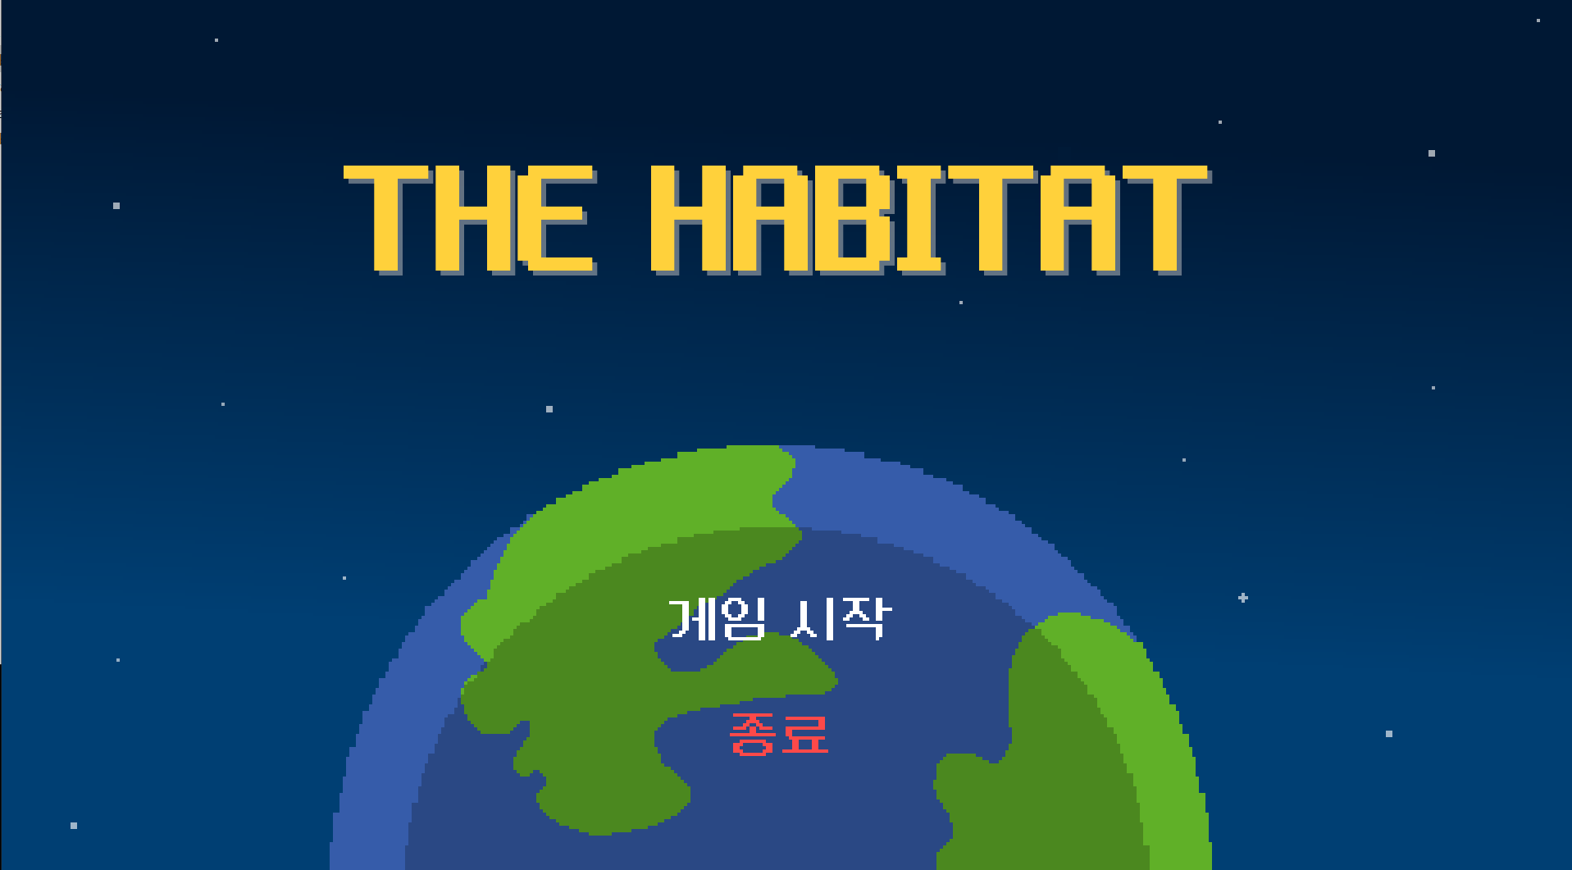
About Project

Slide 4
About Project
nature
THE HABITAT
people
animal

Slide 5


Tool

Slide 6
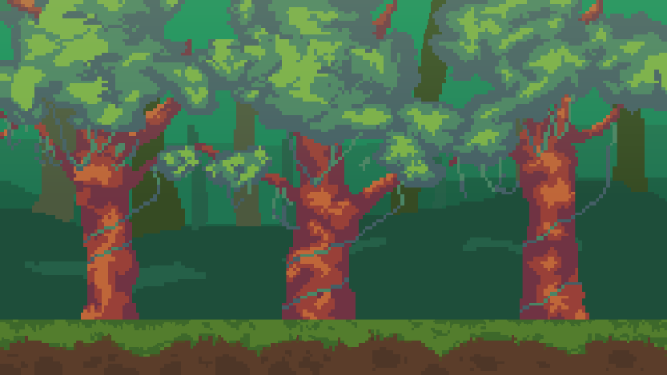
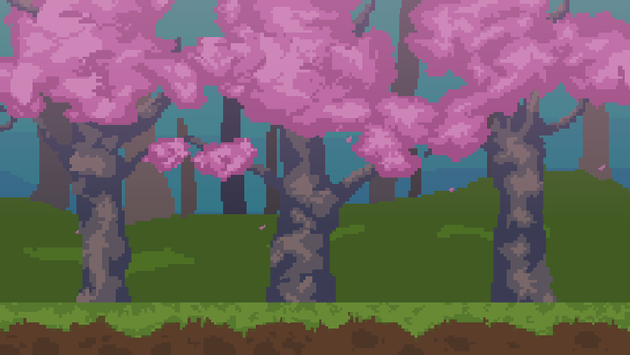
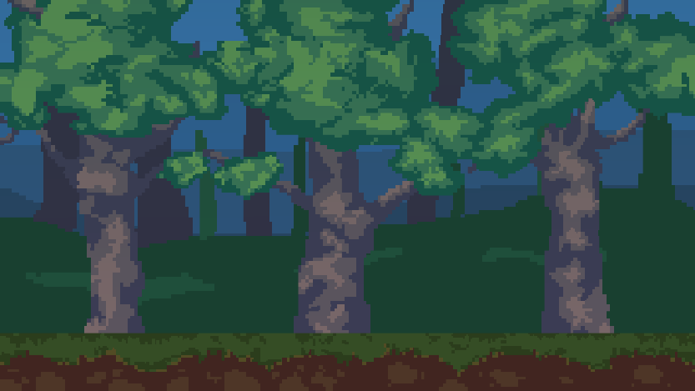
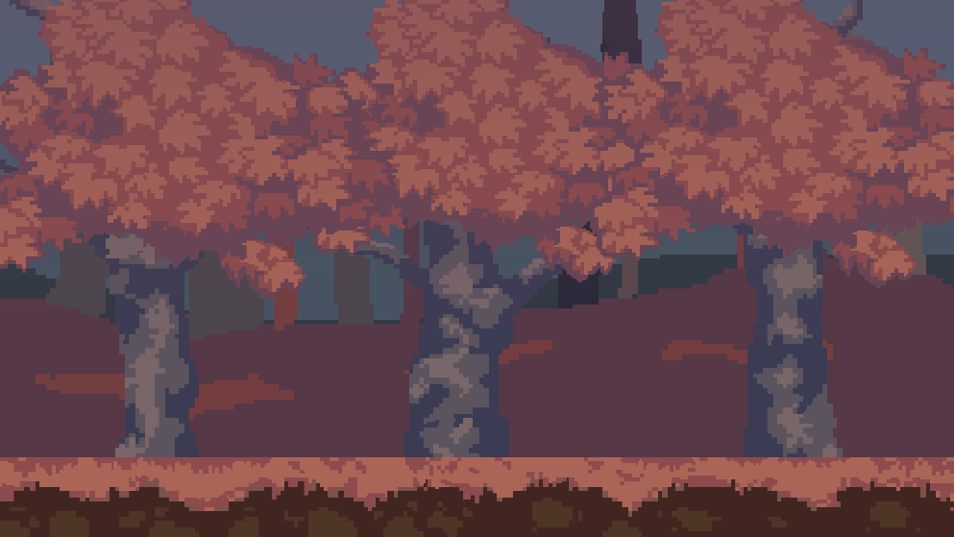
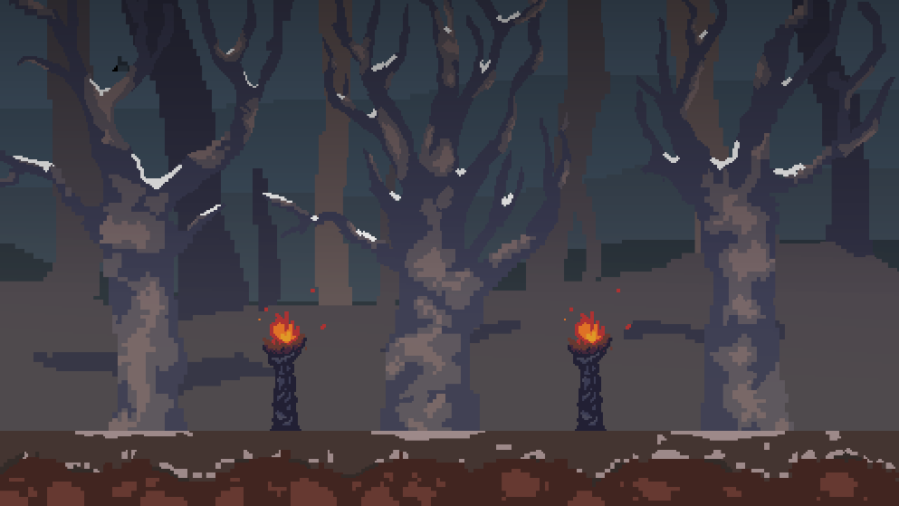
About Project

Slide 7
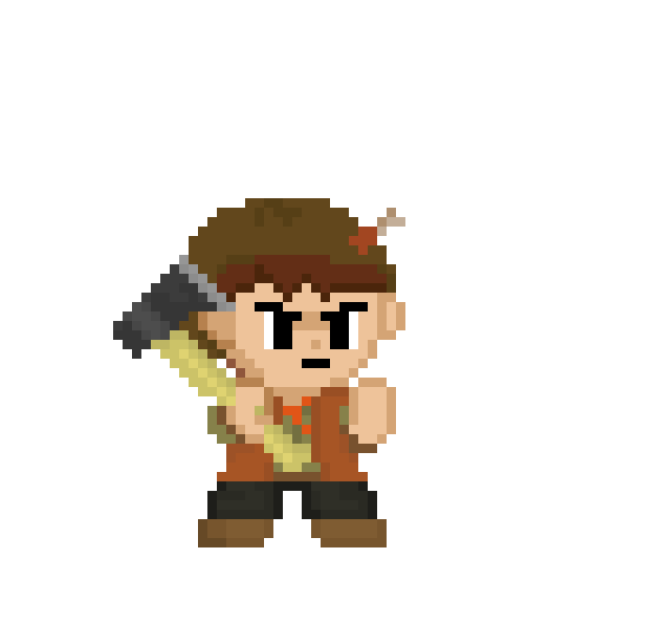
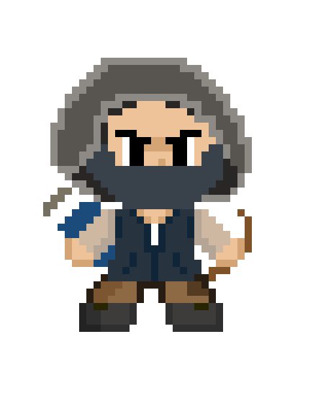
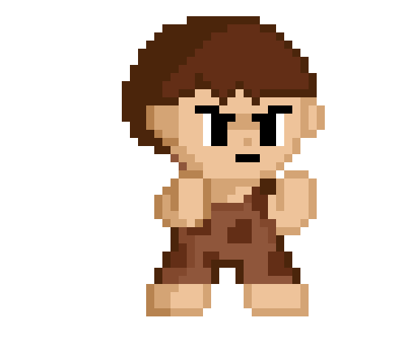
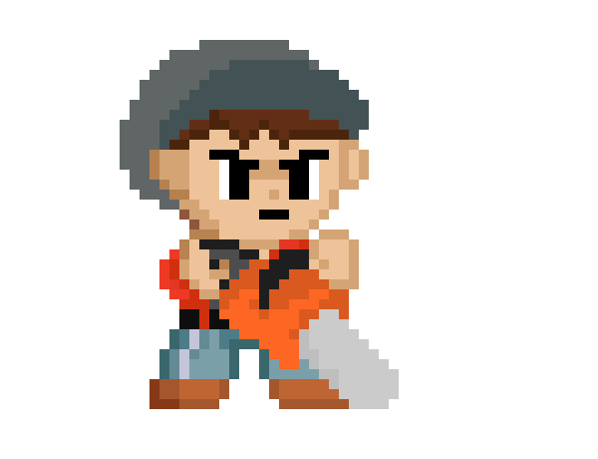
About Project
modernization
Stage 01
Stage 02
Stage 03
Stage 04

Slide 8
About Project
modernization
Stage 01
Stage 02
Stage 03
Stage 04

Slide 9
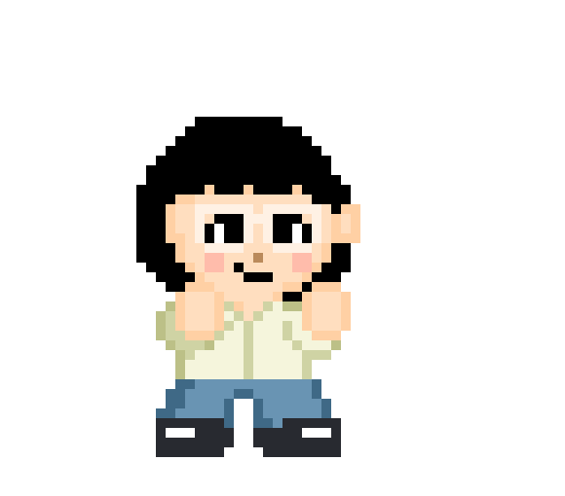
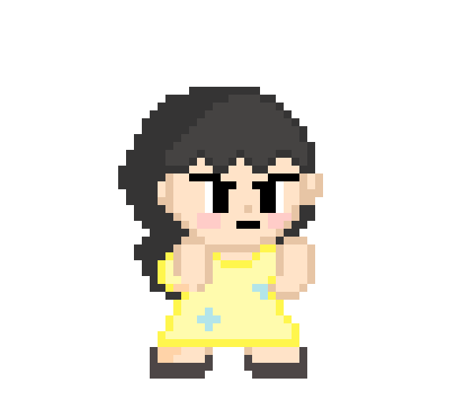
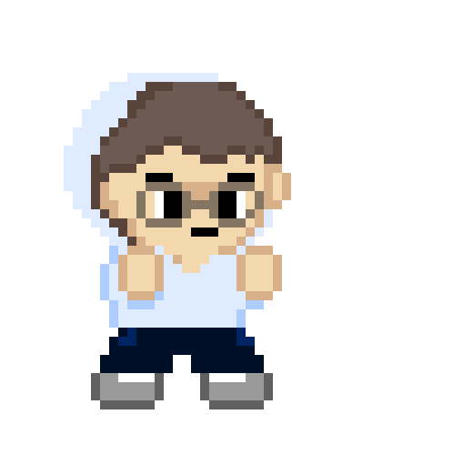
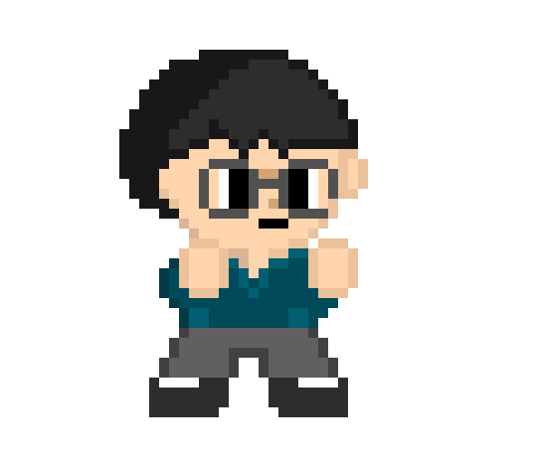
About Project
Boss stage

Slide 10
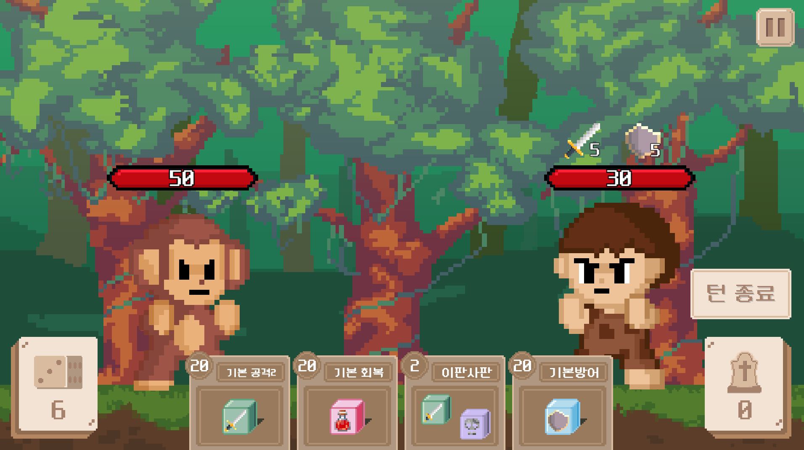
About Project
Play rule

Slide 11
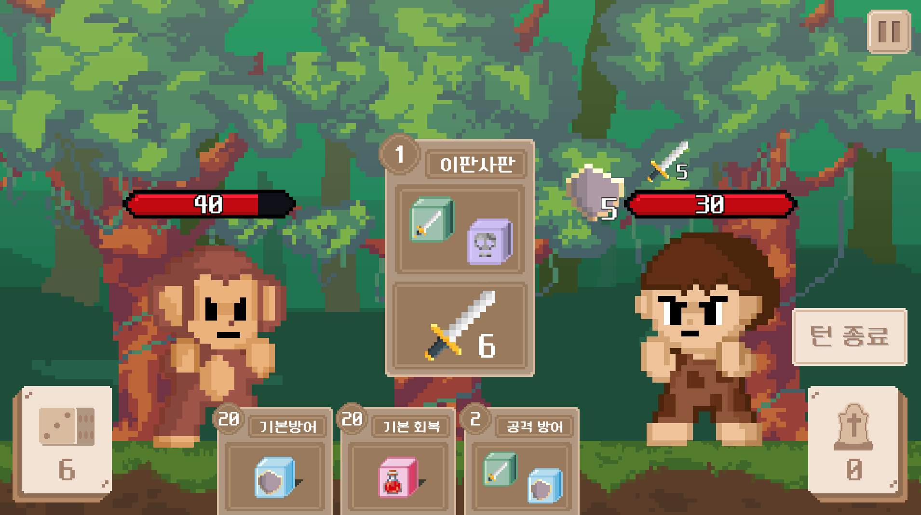
About Project
Play rule

Slide 12
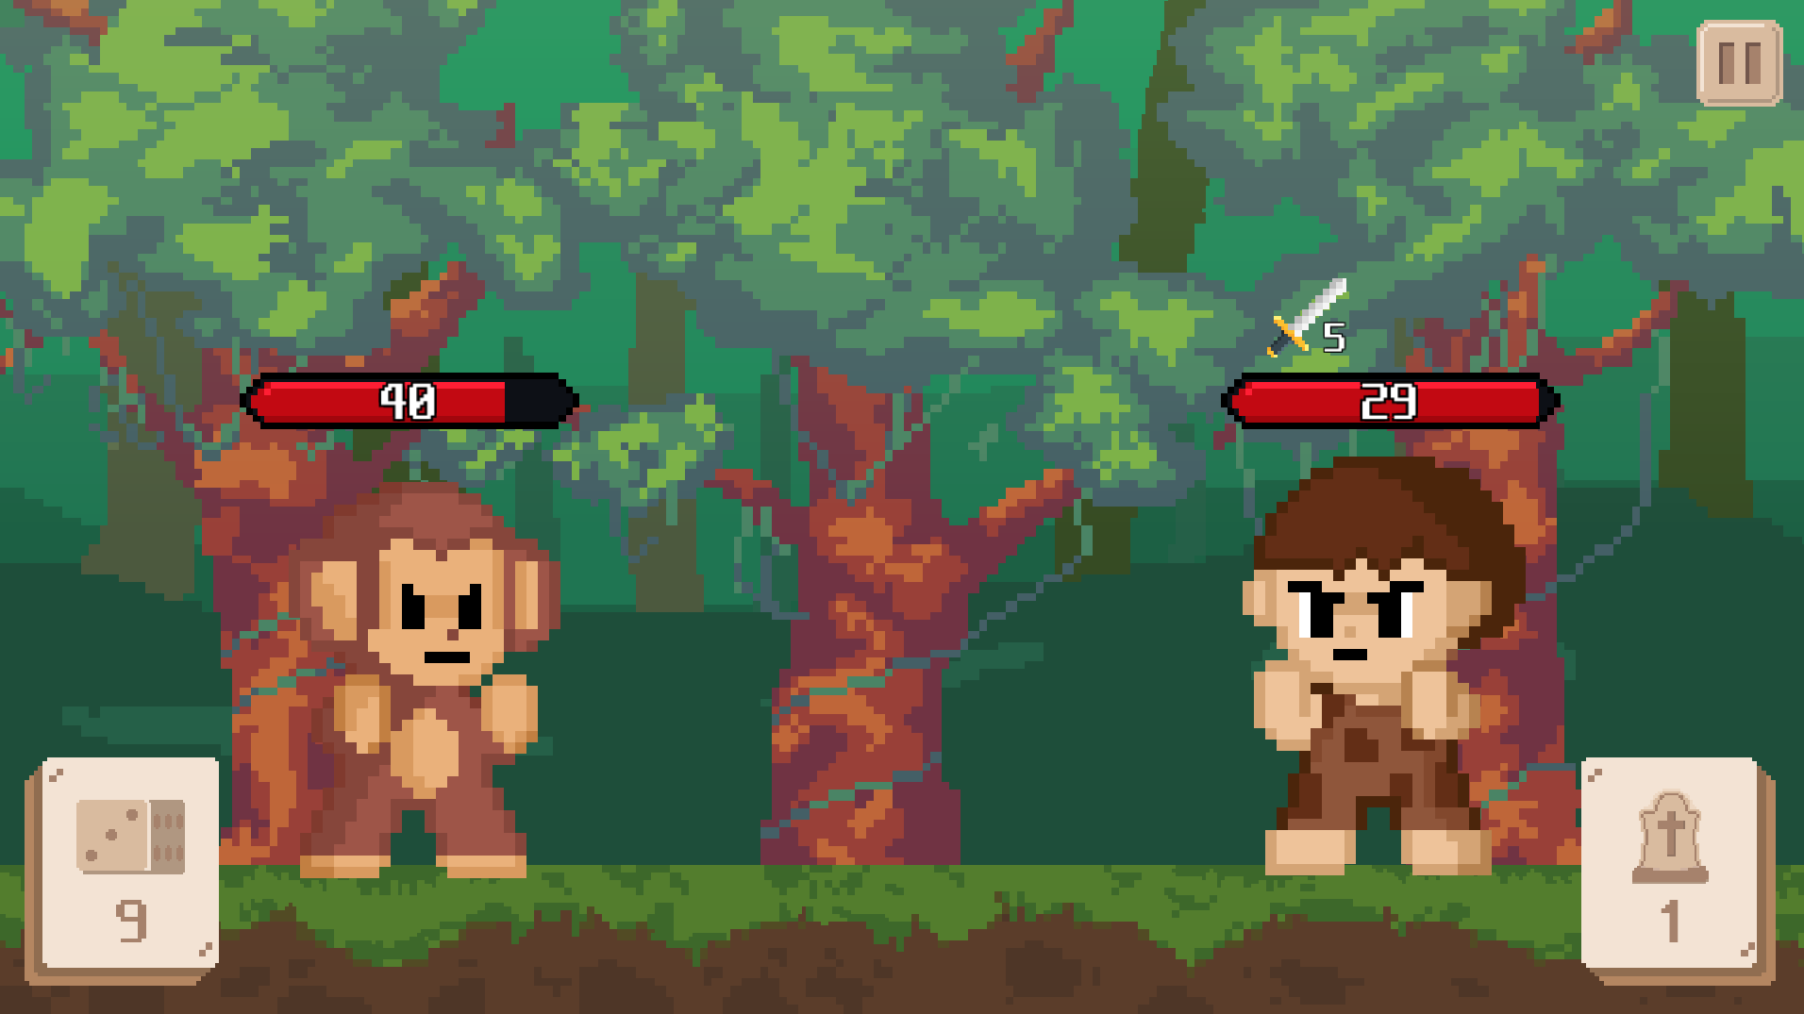
About Project
Play rule

Slide 13
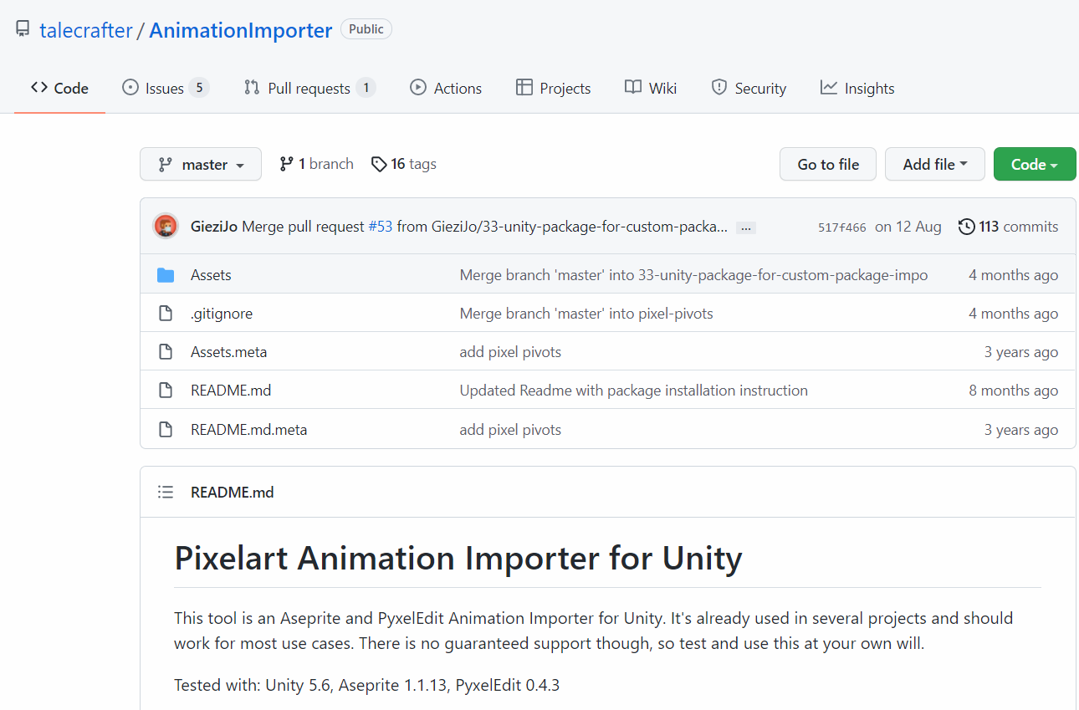
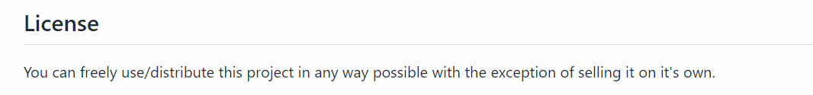
Open-Source Library
Aseprite Importer
In order to create fast animations for ‘Aseprite’

Slide 14
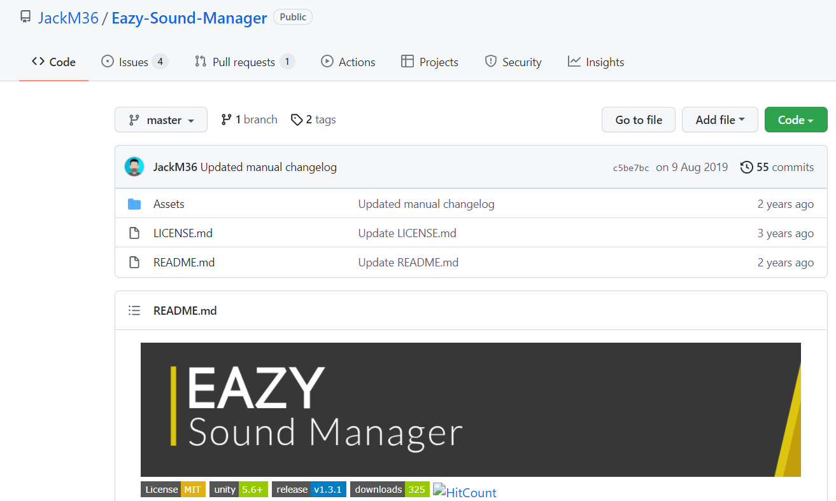
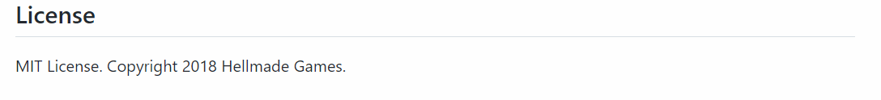
Open-Source Library
Easy Sound Manager
To play background music and other sounds easily

Slide 15

Open-Source License

Slide 16
Team 5
강태훈
Game implementation. Character design
김유정
Each stage game screen and background design
UI, Character design
이연비
Main screen design
UI, Character design
이하형
Design and apply character motion that suits card skills

Slide 17
Team 5
 | Design | Game function | Decision
12/12 | Battle scene, main scene Pause, close button deck, grave button Card design | Card, data setting, deck list Hand function | Font
12/15 | Monster 2, 3 design Character motion Dice, component icons design | Grave button function Enemy, player function Database | SFX sounds
12/18 | Monster 4, 5 design Monster 2, 3 motion Ending scene | Battle function, victory & defeat decide function Get card, delete card function Enemy’s drop card list Stage select function | Background Music
12/20 | Monster 4, 5 motion | Direction (SFX, BGM, Animation) Bug fix, Balancing

Slide 18
